Slide 1
Software Engineering Concepts (CSC205)
Lecture 9

Slide 2
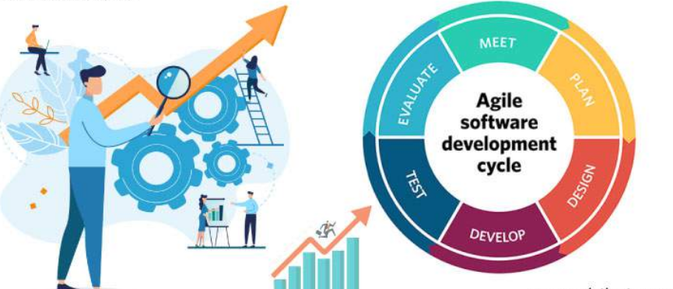
Agenda
Feature, Scenario, and Stories

Slide 3
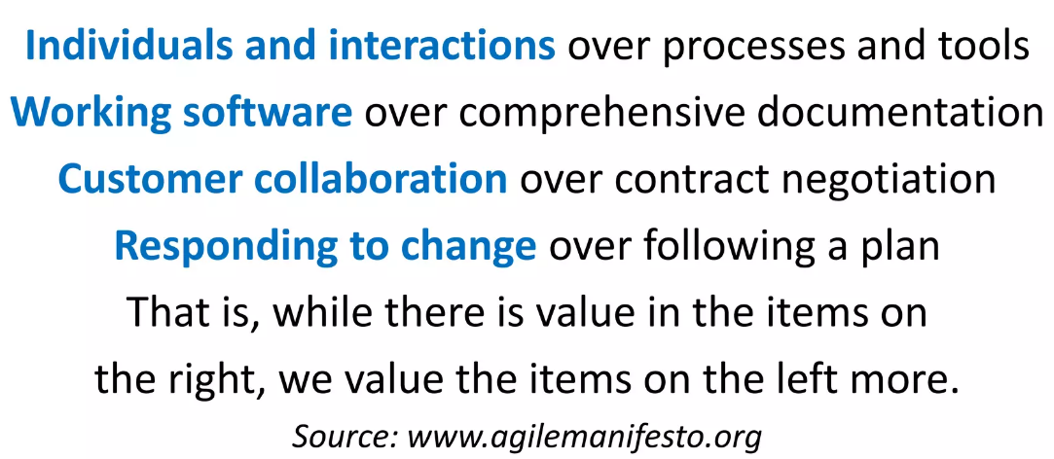
Agile Manifesto

Slide 4
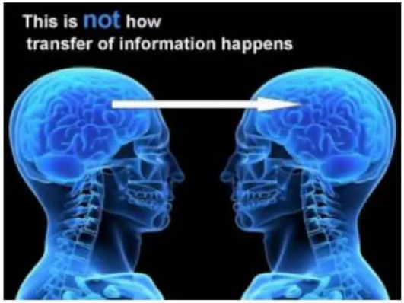
Project Management is all about COMMUNICATION
People who wants a SW product must communicate with people who can BUILD it!!

Slide 5
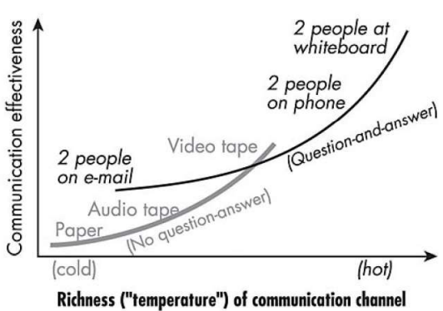
Effective Communication

Slide 6
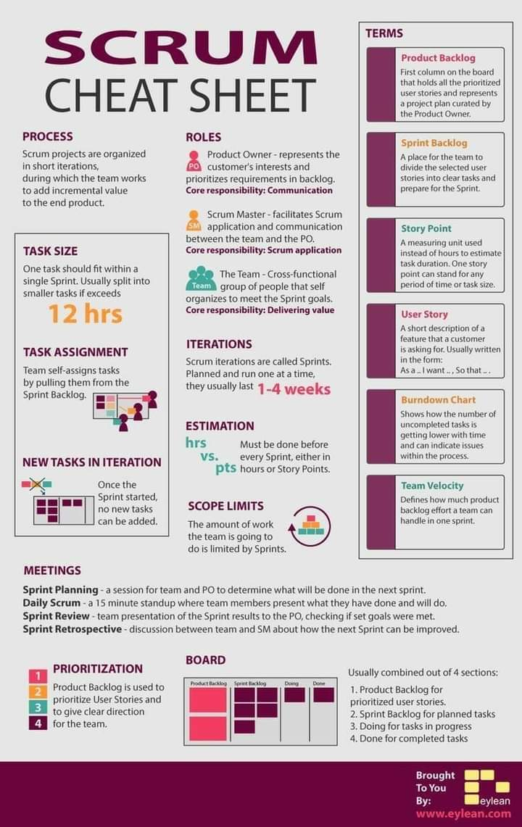

Slide 7
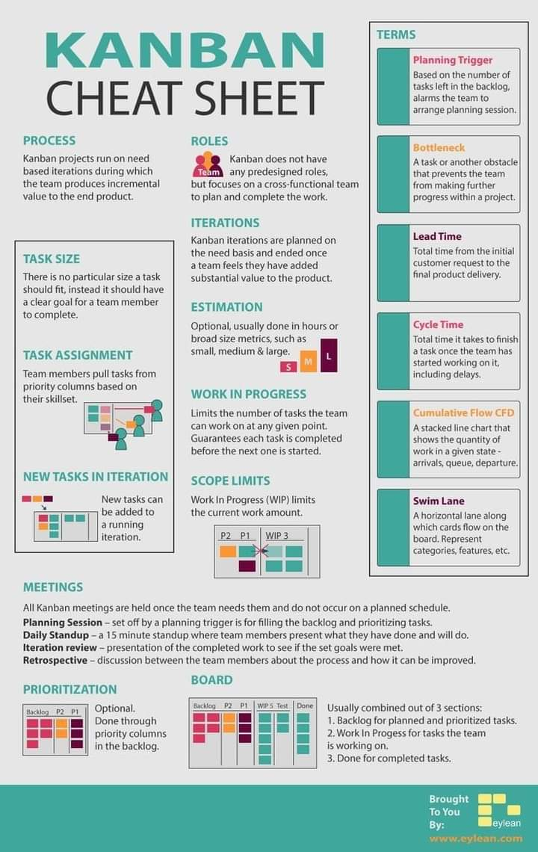

Slide 8
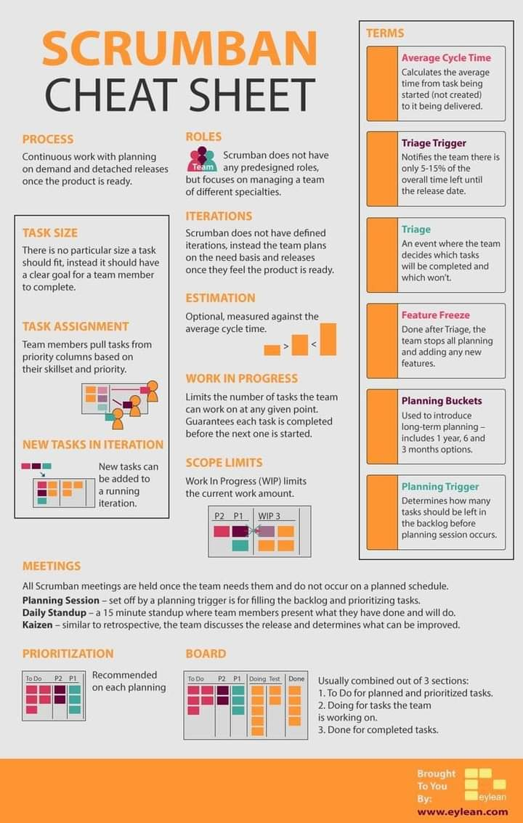

Slide 9
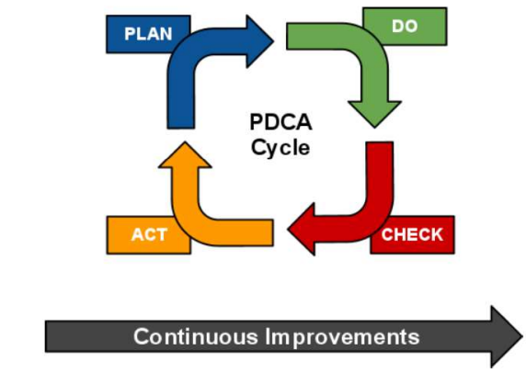
PDCA Cycle

Slide 10
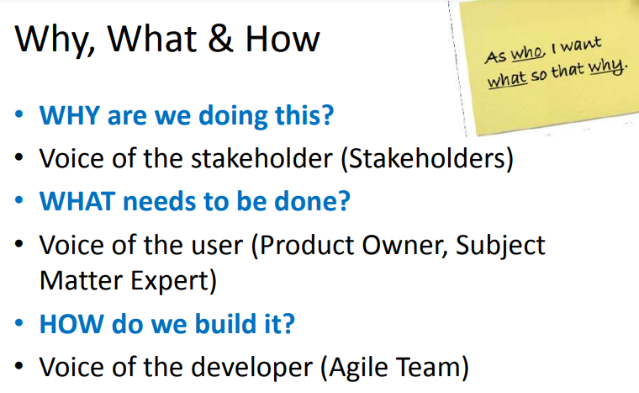

Slide 11
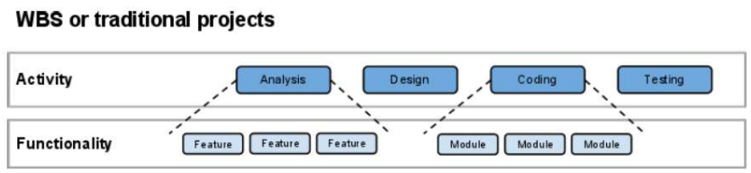
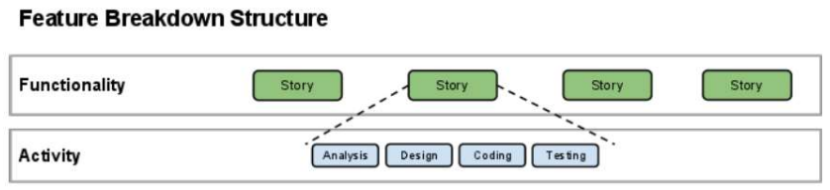
Alternative to Work Breakdown Structure (WBS)

Slide 12
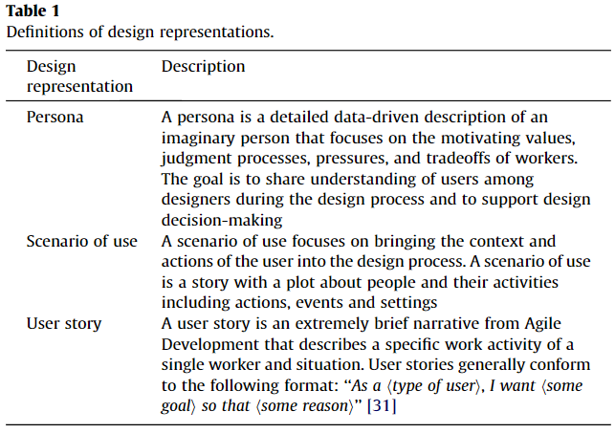
https://linkinghub.elsevier.com/retrieve/pii/S153204641300049X

Slide 13
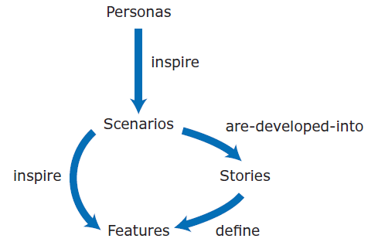

Slide 14
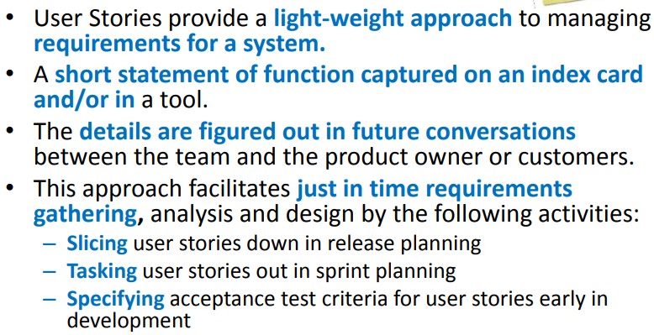
What is a User Story?

Slide 15
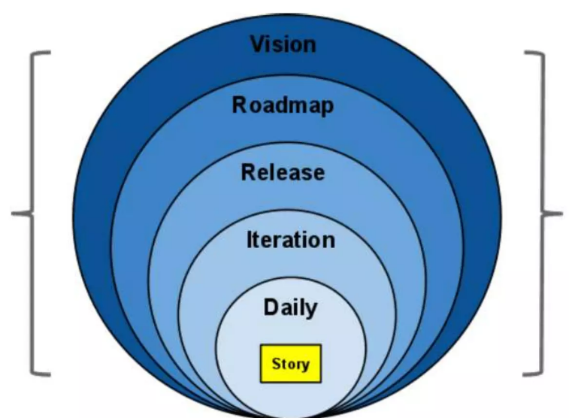
User Stories in ASD

Slide 16
Why User Stories are so Good?
Understood equally well by everyone
Useful for iteration planning
Great for iterative development
Encourage deferring of details
Support opportunistic design
Emphasize verbal communication

Slide 17
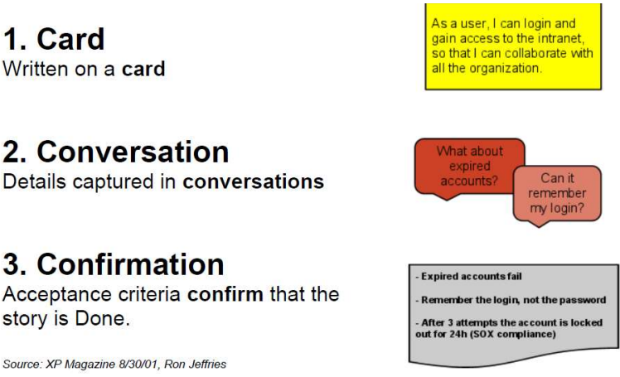
The 3 C's

Slide 18
What is a Story Card?
Short description of user or customer valued functionality.
The visible part of a story, which is followed by conversations between the customer and the project team and confirmation of acceptance criteria.
The customer team writes the story cards because they are in the best position to express the desired features and because they must later be able to work out story details with developers and to prioritize the stories.
The customer team includes those who ensure that the software will meet the needs of its intended users. This may include testers, product manager, real users and interaction designers.

Slide 19
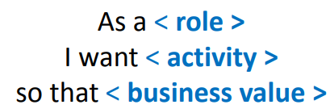
Story Form/ Template I
Role - represents who is performing the action. It should be a single person, not a department. It may be a system if that is what is initiating the activity.
Activity – represents the action to be performed by the system.
Business Value – represents the value to the business. Why is this story important?

Slide 20
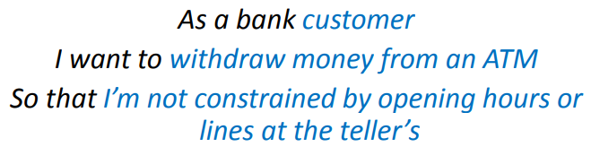
Story Form/ Template I: Example

Slide 21
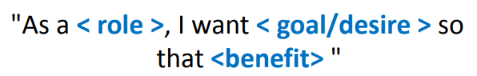
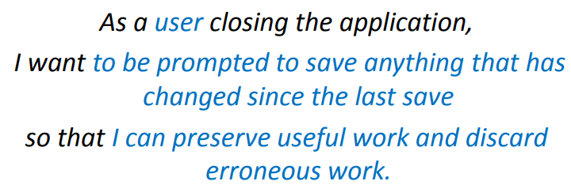
Story Form/ Template I

Slide 22
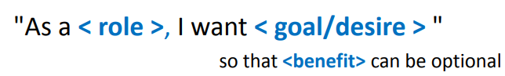
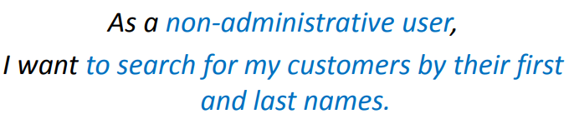
User Story Form/ Template II

Slide 23
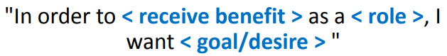
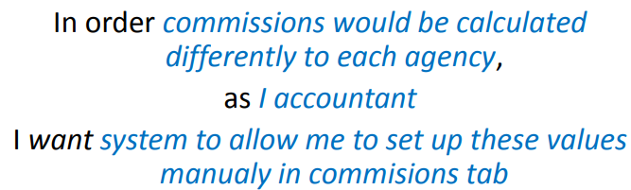
User Story Form/ Template III

Slide 24
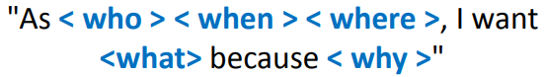
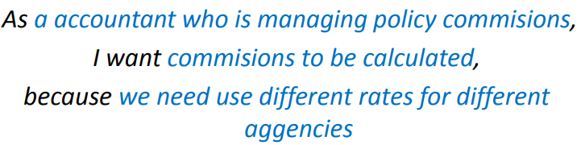
User Story Form/ Template IV

Slide 25
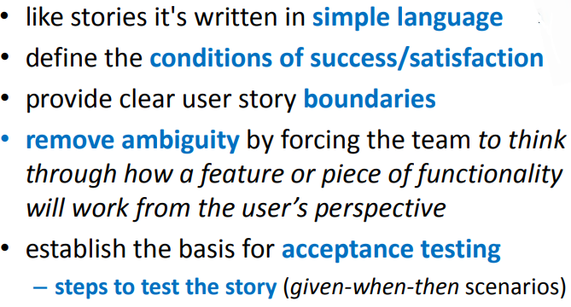
Acceptance/Validation Criteria

Slide 26
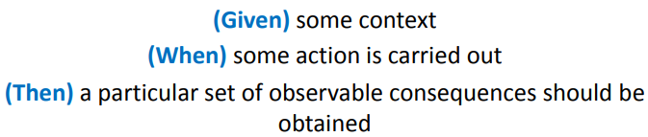
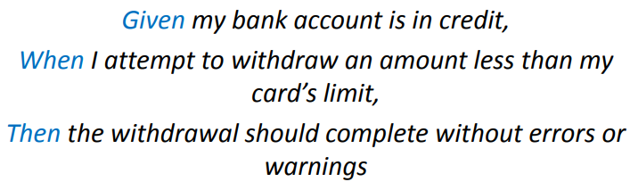
Acceptance Test Form/ Template

Slide 27
Non-Functional Requirements Do User Stories Really Help?
Agile teams focus on identifying User Facing Features in the form of User Stories that can form the basis of incremental deliveries.
Business Analysts work closely with stakeholders to understand what user stories must be satisfied by the product that they are developing.
A flaw in this approach can be that users don’t mention non-functional requirements (NFRs) and developers don’t push to understand what quality attributes the software should satisfy.

Slide 28
Consider Non-functional Requirements from the Start
Most software systems are in use for many more times longer than they take to build. So you need:
Start conversations about the operating environment and user expectations early.
Talk about the quality capabilities of the system, like performance and security, at the start of the project.
Hold a session with the team to brainstorm risks to consider what are the things that can go wrong once the system is live?

Slide 29
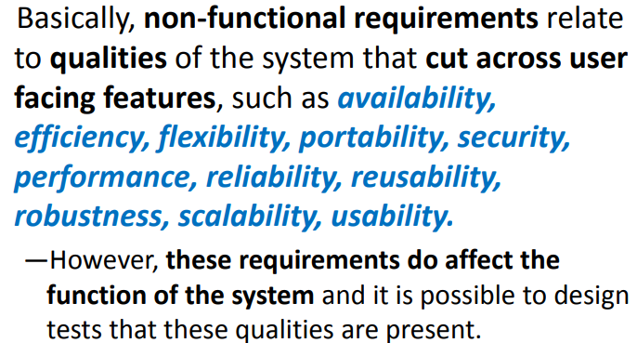
Types of Non-functional Requirements

Slide 30
NFRs Can be Grouped Into
Execution qualities, such as performance and usability, which are observable at run time.
Evolution qualities, such as testability, maintainability, extensibility and scalability, which are embodied in the static structure of the software system.
Agile teams need to consider both categories of NFRs so how do we ensure that these don’t get missed?

Slide 31
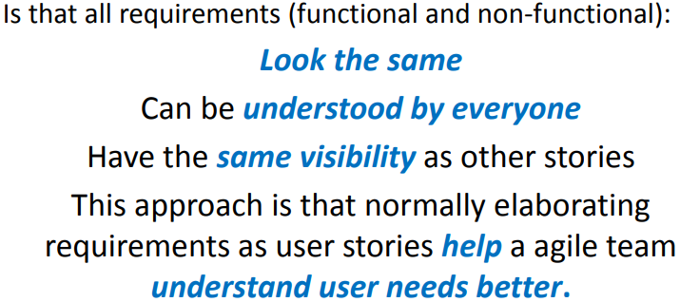
The beauty of User Stories for Non-Functional Requirements approach

Slide 32
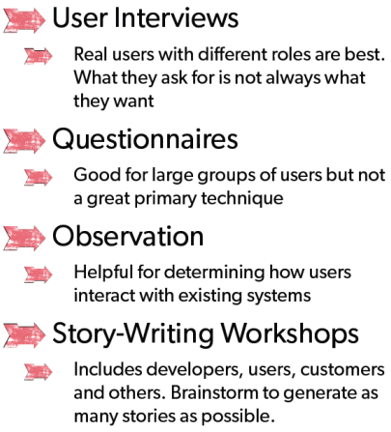
How do we gather user stories?

Slide 33
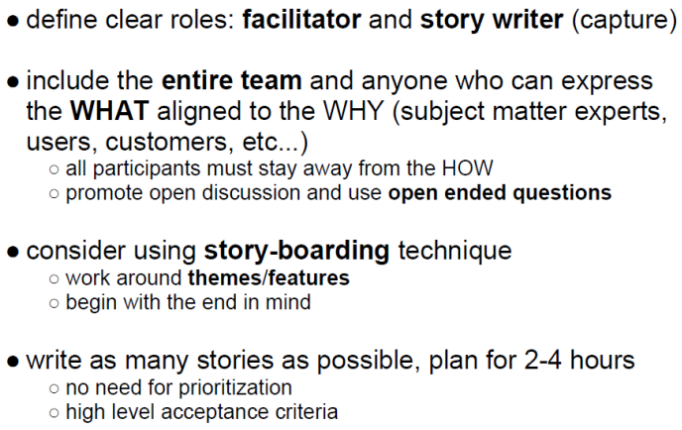
Story Writing Workshop

Slide 34
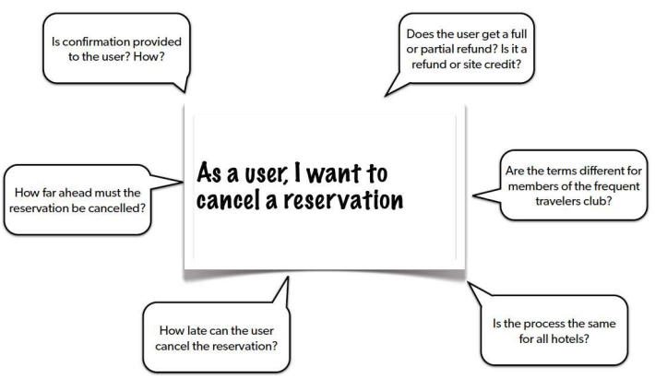
Where are the Details?

Slide 35
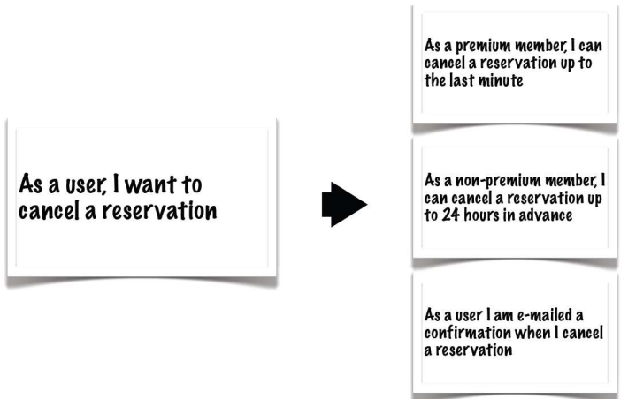
Details added as smaller User Stories

Slide 36
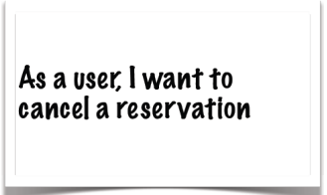
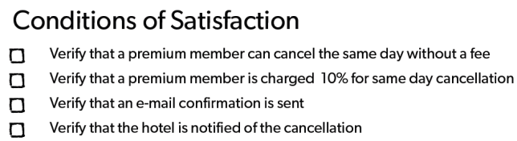
Details as conditions of Satisfaction/ Acceptance Criteria

Slide 37
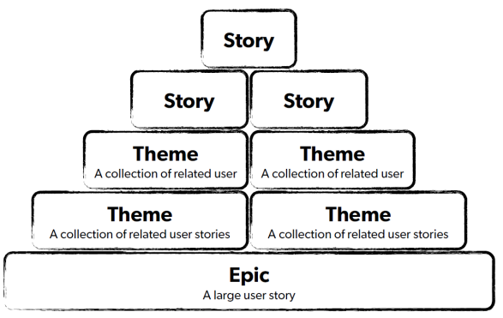
Types of User Stories

Slide 38
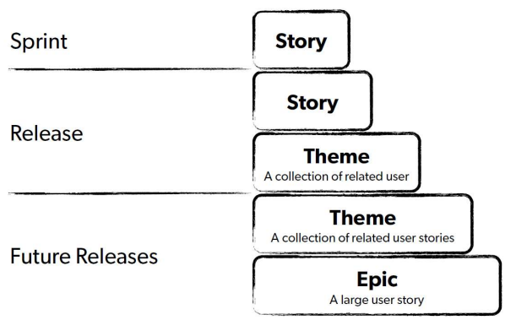
The Backlog Iceberg

Slide 39
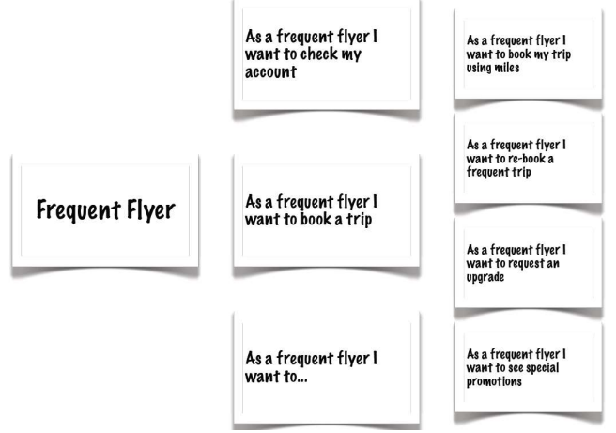
Breaking Down Epics

Slide 40
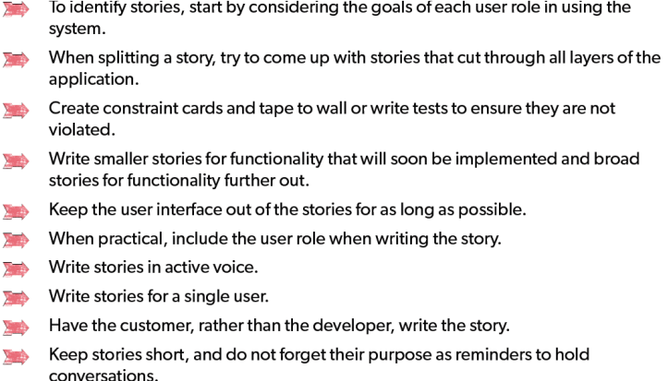
Tips for Writing Good Stories

Slide 41
